Slide 1
Initial Briefing Semester 2 2022-2023 Industrial Training

Slide 2
Content
Industrial Training Calendar
Pre-requisite(s)
Applying for LI
LI Abroad
5 Star Companies
Final Year Project (FYP)
Logistics
Industrial Training Implementation
Visiting Lecturer
Evaluation Criteria
Work Ethics

Slide 3
Industrial Training Calendar
Three (3) phases:
Company/Organization Selection.
Training (by student) and Evaluation (by lecturers and supervisor).
Documentation and Grading.

Slide 4
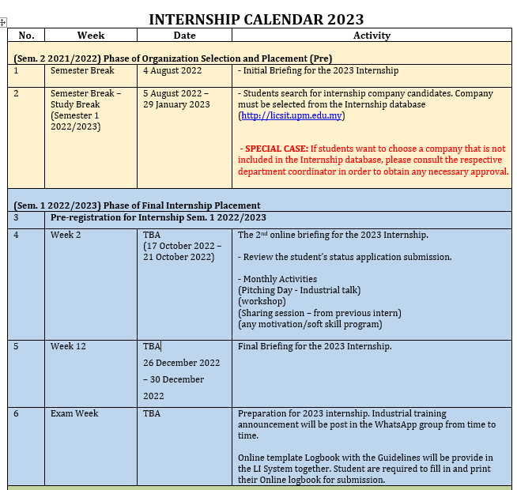
Industrial Training Calendar

Slide 5
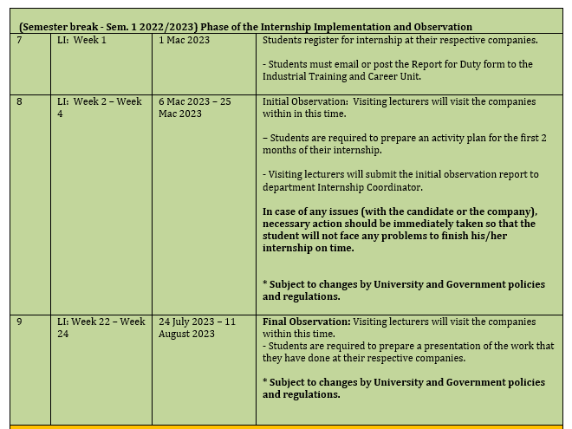
Industrial Training Calendar

Slide 6
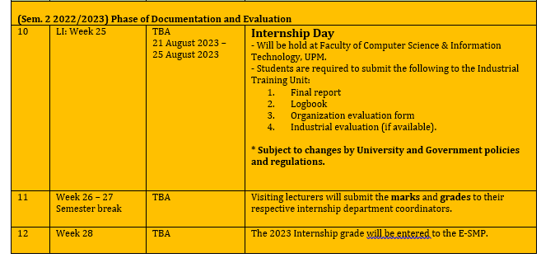
Industrial Training Calendar

Slide 7
Prerequisite
To enroll for LI 2023 (SKM/SKR/SSK/SSE 4901), students should have fulfilled their prerequisite courses based on department:
Multimedia: Prerequisite = SKM3300, or with the approval of the Department.
Network: Prerequisite = SKR3504 or with the approval of the Department.
Computer Systems: Prerequisite = SSE3001 and SSK3408, or with the approval of the Department.
SE/IS: Prerequisite = SSE4300 and with the approval of the Department.
Students are not allowed to enrol in other subjects while doing the LI 2023

Slide 8
How to Apply for LI?
List of companies/organizations in the database
Please visit http://licsit.upm.edu.my/
Username : UPM ID
Password : UPM ID PASSWORD
Students are advised to regularly check the announcement in the LI System since the LI Unit might post vacancies from companies not in the database.
Students are expected to do their due diligence (research) on the chosen companies/organizations, particularly the following matters:
Job scope (must be related to computer science / ICT)
Special note for Multimedia students… Design/creative works should not be the main task during your LI 2022.
Allowances
Transportation to and from the work place
Costs (including accommodation, transportation, food etc.)
Safety
Please choose your companies/organizations carefully.

Slide 9
How to Apply for LI?
Enter the LI System - http://licsit.upm.edu.my/
Update information in basic profile
Fill in resume
shortlist THREE potential companies/organizations
Send the application to the 3 potential companies/organizations.
The system will generate result semester from SMP and application letter
Follow up the choosen company
Student need to update placement in the LI System after accept the offering. Once you accept the offer, the other applications will be automaticcaly cancelled.
Student need to make a new application if there is any UNSUCCESSFUL applications

Slide 10
Logistics Issues
Please ensure all logistic issues as the followings have been taken care before you start your LI.
Location
Housing
Transportation/ journey to work place.
Cost of living
Allowances
Safety
FSKTM and UPM will not provide all of the above.

Slide 11
LI Abroad
The University’s JINM Office will only sponsor THREE (3) students from each faculty (Candidates must possess a CGPA > 3.0)
What’s provided by the JINM Office:
Return Flight Ticket and Flight insurance
Allowance:
RM1,000 for the first month
RM500 for the following months
Note however that policies might change at the discretion of the university
For example, quite recently, UPM only sponsored for the 1st month
Students are encouraged to find companies that provide accommodation, insurance and allowances.
Each of the chosen faculty students, must apply for LI at different countries (you cannot go to the same country)
* PLEASE REFER TO JINM OFFICE FOR THE NEW INFORMATION

Slide 12
5 Star Company
Multi National Companies
Price Water Coopers
Intel
DELL
DHL
Hilti
Goverment Link Company
Petronas

Slide 13
Final Year Project
Students who fail FYP are not allowed to take the LI course

Slide 14
LI Implementation
Before performing the LI, all students MUST register for ‘kursus Latihan Industri’ at the ESMP. (SSK4901, SSEM4901, SKR4901, SKM4901).
The GRADE will not be included in the SMP for STUDENTS who FAIL to register the course
Please ensure you fulfill the prerequisites.
The duration for internship (LI) is 24 weeks.
You cannot take leave. Any leave taken must be replaced ☺
12 credits.
Student are not allowed to change companies after receiving acceptance letter. Any changes will not be entertained. Marks will be deducted from final total marks should there be any changes made without permission.
Students need to submit all the documents to their coordinator. If the students do not submit their documents, you will get Grade E for your 12 credits.

Slide 15
Application Leave
Students are not allowed to take leave during industrial training unless permitted by their organisation.
Students who are absent for more than 6 days (unless due to emergency or sick leave) are considered as not fulfilling the requirement for industrial training. Thus, they will have to repeat their industrial training again in the following semester.
Please plan well ahead so that it will not affect your attendance.

Slide 16
Visit from Visiting Lecturer
Appointed Visiting lecturer will perform two visits:
Initial Observation Visit (within LI Weeks 2-4).
Final Observation Visit (within LI Weeks 22-24)
Initial observation – to ensure the chosen company is appropriate for the students and solve any relevant issues.
Final observation – to evaluate the overall internship performance based from their work performance/achievement, report, presentation, attitude and attendance.
All evaluations will be recorded based on ISO UPM procedure.

Slide 17
Evaluations Criteria
The overall evaluation for LI 2021 are as follows:
Final Report(40%) – Submitted during the Internship Day
Industrial Supervisor Evaluation (40%)
Visiting Lecturer Evaluation (10%) – Evaluated during the visit
Log Book (5%)
Attendance (5%)
Please submit all documents to Unit Latihan Industri dan Kerjaya, FSKTM.

Slide 18
Work Ethics
Attire -> Whatever that has been set by the company/organization
Please be punctual
Early preparations
Study about the company.
Read all the rules and regulation.
Revise several system that might use in that company.

Slide 19
Lessons to learn
Not serious and last minute search for companies – resulted inappropriate company.
Looking for higher allowance rather than more potential learning experiences.
Reject offer from 1st company and expecting other company and finally none company to choose.
Not much support from UPM for oversea company, only flight ticket and small amount of allowances.
12 credits = 4 subjects with 3+0 credit

Slide 20
Reminder
Second briefing will be held in Week 2, Semester 1 2022/2023
Final briefing will be held in Week 12, Semester I 2022/2023
Please contact your LI Department Coordinator if you have any problems.

Slide 21
CONTACT US
Contact us :
Dr. Salfarina Abdullah (012-3632118) – Head of Unit LI
Dr. Nor Azura Husin (011-12819303) –JSK Coordinator
Dr. Alfian Abdul Halin (012-5579140) – JMM Coordinator
Dr Ts Mohd Hafeez Osman (019-2544787) - JKPSM Coordinator
Mr. Ahmad Alauddin (019-3173774) - JTKR Coordinator
Admin. assist, Pn Norbaayah, 013-3519054

Slide 22
Q & A

